Slide 1
Identifying clinically significant features for breast cancer detection
Helena Sofía Yaben Lopezosa
Pablo Laso-Mielgo
Course 2020/2021
Biomedical Engineering Degree
Inference

Slide 2
Introduction
Inference
Biomedical Engineering Degree

Slide 3
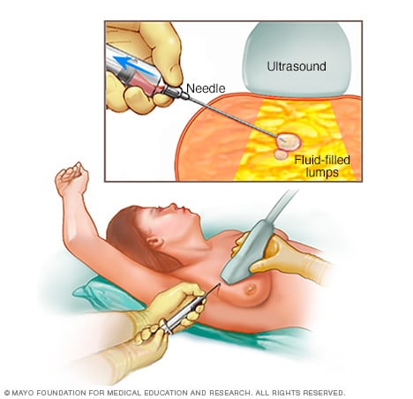
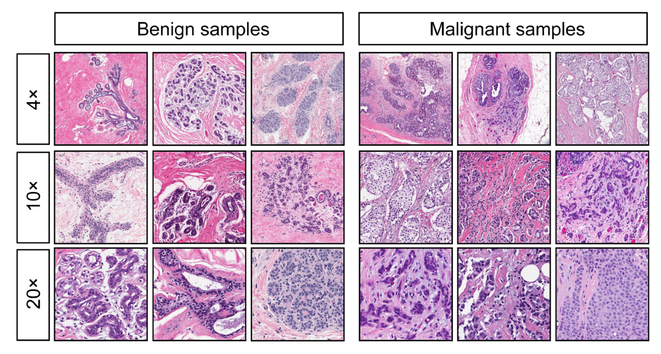
Breast Cancer
Inference
Biomedical Engineering Degree

Slide 4
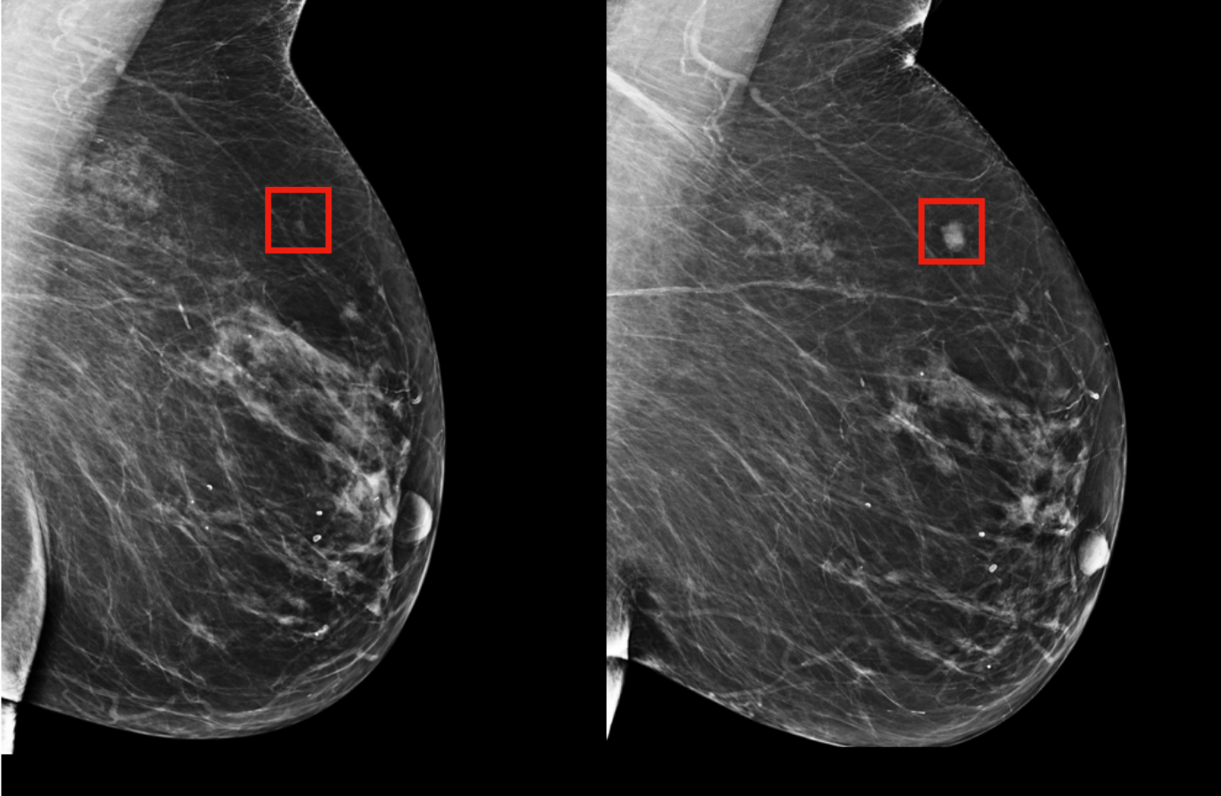
Breast Cancer
Inference
Biomedical Engineering Degree

Slide 5
Features
1. Radius (mean of distances from center to points on the perimeter)
2. Texture (standard deviation of gray-scale values)
3. Perimeter
4. Area
5. Smoothness (local variation in radius lengths)
6. Compactness (perimeter ^2 / area - 1.0)
7. Concavity (severity of concave portions of the contour)
8. Concave points (number of concave portions of the contour)
9. Symmetry
10. Fractal dimension (“coastline approximation” - 1)
Inference
Biomedical Engineering Degree

Slide 6
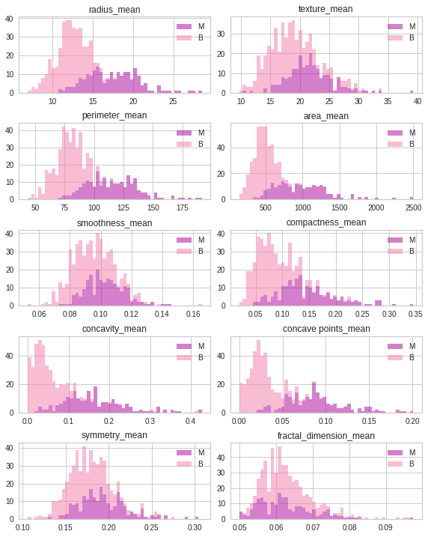
Feature Visualization
Inference
Biomedical Engineering Degree

Slide 7
Feature Analysis
radius_mean | Reject H_0
perimeter_mean | Reject H_0
area_mean | Reject H_0
smoothness_mean | Reject H_0
concavity_mean | Reject H_0
compactness_mean | Reject H_0
concave points_mean | Reject H_0
symmetry_mean | Reject H_0
fractal_dimension_mean | Fail to reject H_0
texture_mean | Reject H_0
Inference
Biomedical Engineering Degree

Slide 8
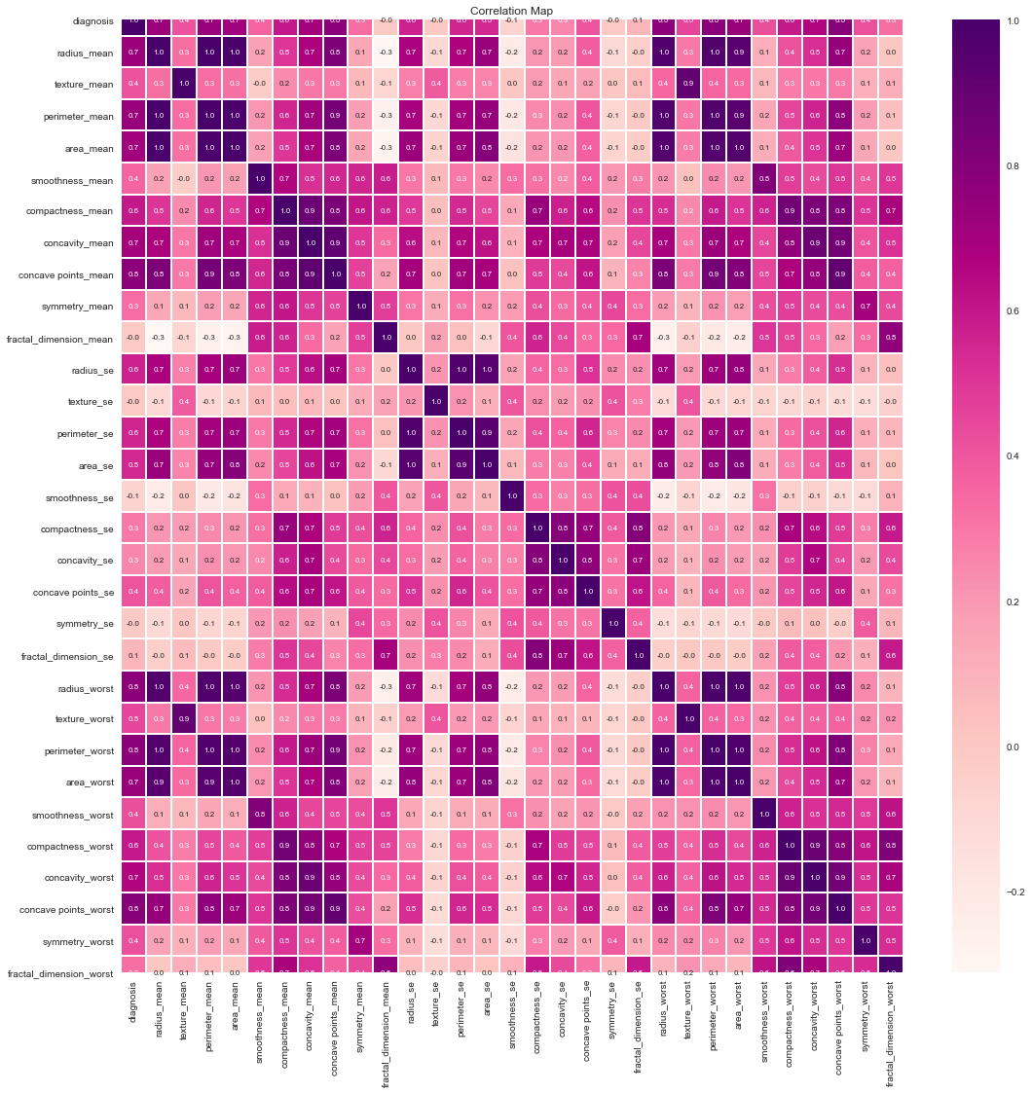
Linear Regression
Inference
Biomedical Engineering Degree
Notes:
Are they linear?

Slide 9
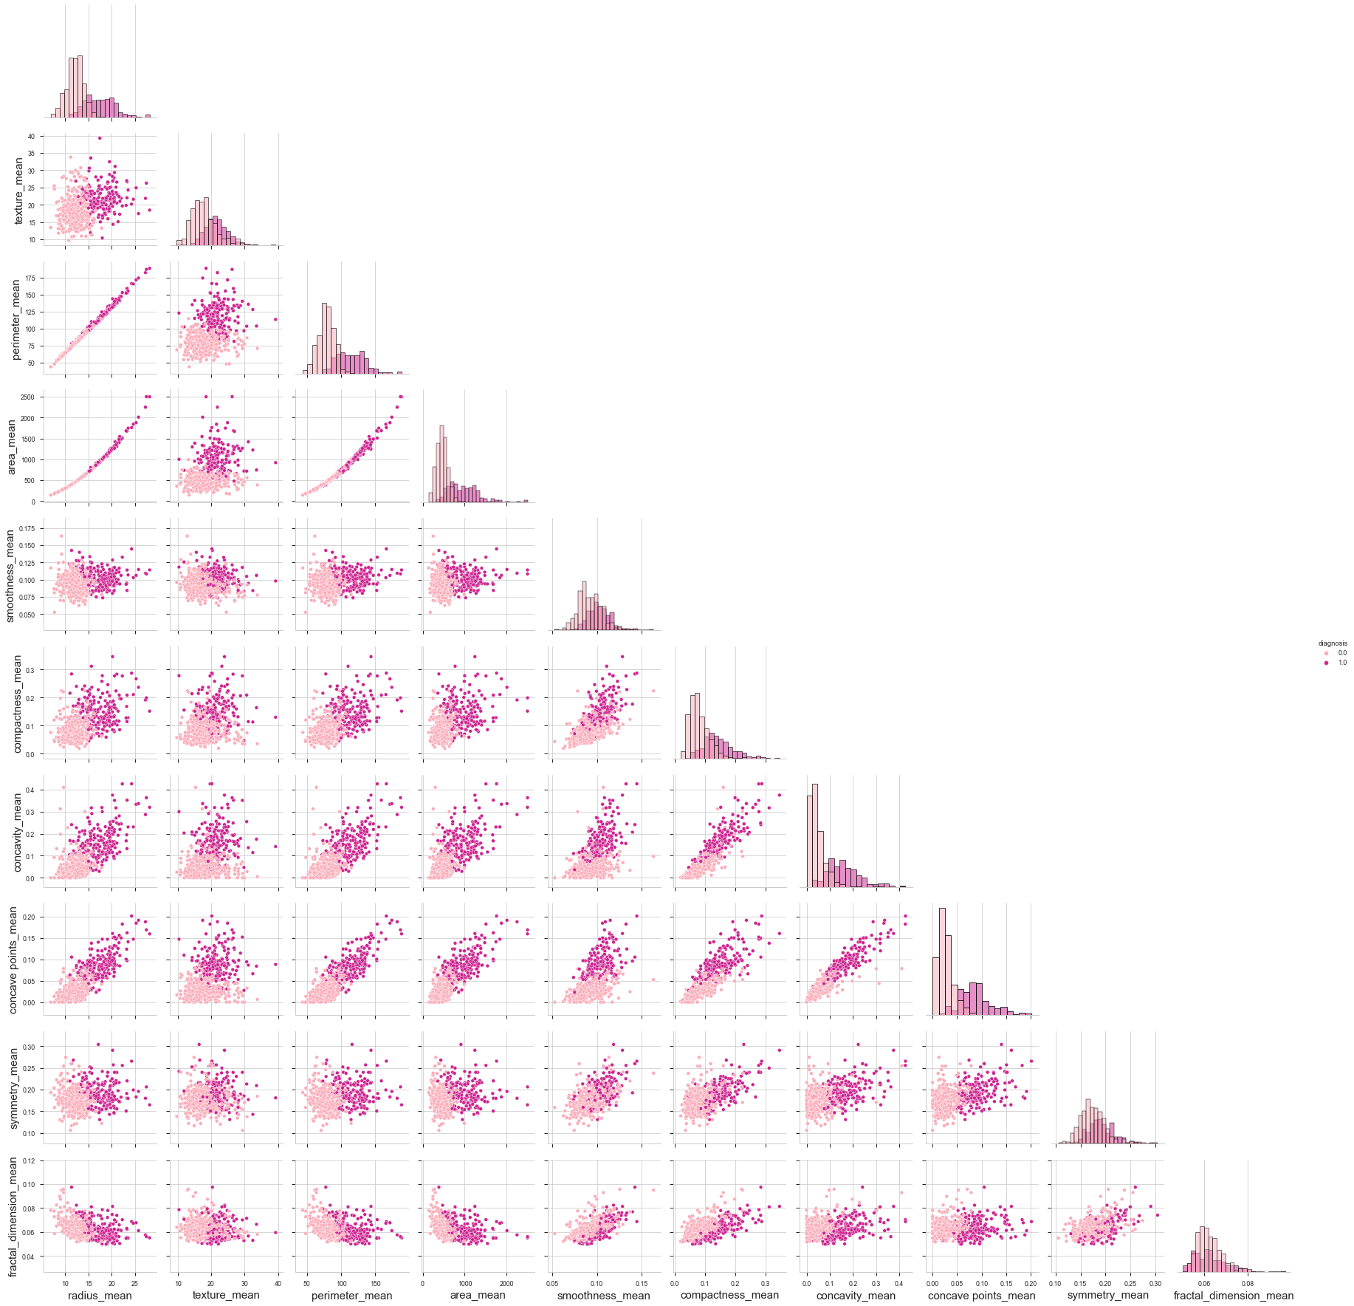
Linear Regression
Inference
Biomedical Engineering Degree
Notes:
Homoscedasticity

Slide 10
Conclussions
1. Mean values for radius, texture, perimeter, area, compactness, concavity and concave points seem to be larger in malignant tissue. Therefore, these variables may be useful for our analysis.
2. Mean values for smoothness and simmetry do not seem to change significantly between benignant and malignant tumors. After performing hypothesis testing, we realize that, albeit not at first glance, they can be somehow used to discriminate malign from benign cases, although to a smaller extent than the aforementioned features. Therefore, these variables may not be that powerful for our analysis, yet still useful.
3. The Mean value for fractal dimension does not seem to change significantly between benignant and malignant tumors. Besides, our statistical analysis conclude that the mean for malign and benign distributions for this feature are equal (H_0, which we failed to reject). Therefore, this variable may not be that relevant, being our statement grounded on visualization, and statistical tools.
Inference
Biomedical Engineering Degree

Slide 11
Conclussions
In order to perform LN, several conditions must hold:
Linearity.
Homogeneity.
Homoscedasticity.
Independence.
Normality.
We should get rid of those features with a Correlation Coefficient < 0.9 in the heatmap.
Inference
Biomedical Engineering Degree

